Slide 1
Thales of Miletus
640 - 546 BC
Journey Through Genius Pp 6
Notes:
Around 600BC on the western coast of Asia Minor, in a town called Miletus lived the great Thales, of the so-called “Seven Wise Men”
Seven Wise Men: Pittacus of Mytilene, and Bias of Priene, and our own Solon, and Cleobulus of Lindus, and Myson of Chenae, and the seventh of them was said to be Chilon of Sparta
He is known for being the father of demonstrative mathematics, diving into the “why” along with the “how”, thus he is considered the earliest known mathematician
Thales was a mathematician and an astronomer who somehow predicted the solar eclipse in 585 BC, known for “know thyself”
He is known for being absent minded, according to legend, he was once strolling about, gazing at the stars and tumbled into an open well
Thales is also remembered for being unkind to men and animals, not in an outwardly abusive type of way, but in an insensitive way.
His insistence that geometric statements not be accepted based on their intuitive plausibility, but rather they needed subjecting to rigorous, logical proofs, gave him his reputation in mathematics
Thales was the first to prove, - vertical angles are equal - the angle sum of a triangle equals two right angles - the base angles of an isosceles triangle are equal - an angle inscribed in a semi-circle is a right angle
There is no record of Thale’s proof for any statement above, but in Elements III.31, Euclid’s proof of the last statements is simple and direct enough it is speculated that it may be Thales’ own **insert proof of statement**
Activity: try and prove one of the above statements in the simple and direct Thales method. There were no such thing as angle measurements such as degrees, nor were there any axioms of geometry, have a group participation and discussion.

Slide 2
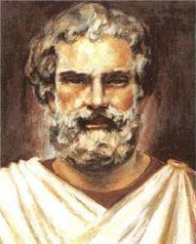
Thales
One of the “Seven Wise Men”
Seven Wise Men: Pittacus of Mytilene, and Bias of Priene, and our own Solon, and Cleobulus of Lindus, and Myson of Chenae, and the seventh of them was said to be Chilon of Sparta
Considered the earliest known mathematician, he was the father of demonstrative mathematics, tackling the “why” and the “how”

Slide 3
Achievements
Predicted the solar eclipse in 585 BC
Known for “know thyself”
First to prove: - vertical angles are equal - the angle sum of a triangle equals two right angles - the base angles of an isosceles triangle are equal - an angle inscribed in a semi circle is a right angle
There are no records of Thale’s personal proofs of these statements, but in Euclid’s Elements III.31, Euclid’s proof is simple enough that it could be Thale’s own

Slide 4
Activity
Let us try and prove one of the statements above, using only simple terms that Thales may have had in his arsenal
There were no angle measurements such as degrees, nor axioms of geometry
**class participation and discussion**
Prove one of the first three statments

Slide 5
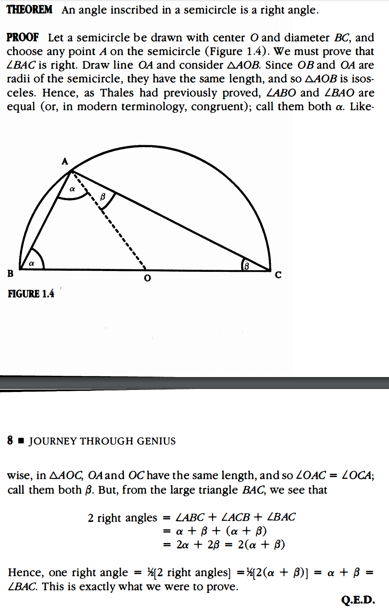
Euclid’s Proof of Thales

